Slide 1
TERADATA: 2020 DATA CHALLENGE
Presented by:
DataBuster (Group-3)
April 20, 2020
Apr 16, 2020

Slide 2
Data Overview
Dataset 1: Project Categories
Overview: Contains the descriptive information outlining categorization of projects
Size: 22 observations / 8 variables
Ex.: ID, business line hierarchy, and updates
Dataset 2: Project Export
Overview: Contains specific project demographic information
Size: 11.5k observations / 27 variables
Ex.: Status information (start/end), descriptive overviews, and engagements
Dataset 3: Project Inquiries
Overview: Information related to Inquiries by volunteers for various projects
Size: 25,085 observations / 17 variables
Ex.: Project Id, qualifications, state, created at, updated at
Dataset 4: User Data
Overview: Contains user account creation and activity information
Size: 184,597 observations / 6 variables
Ex.: ID, account created and confirmation date, non-profit/consultant flag, last log in date

Slide 3
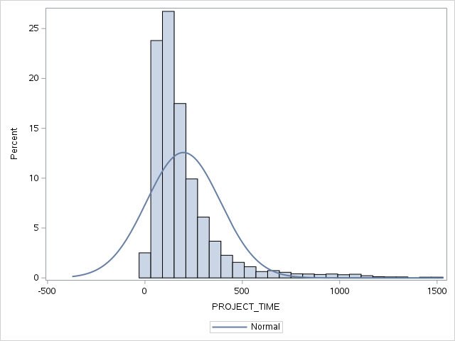
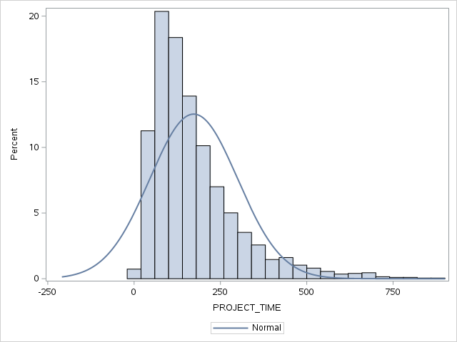
Project Completion Time
Q1
Q2
Q3
Q4
Greatest challenge: Avoiding the easy answer
Methodology
Import & transform the ‘project category’ dataset
Perform initial data analysis
Basic statistical measures
Distribution
ANOVA
P-Value less than .0001 indicated that not all means
are equal
Remove extreme outliers
Conducted on a ‘project category’ basis
Grounds for removal
3x the Interquartile Range
132 observations removed
Before
After

Slide 4
Project Completion Time Continued
Q1
Q2
Q3
Q4
Perform follow up data analysis to measure for improvement
Statistical measures improved
Overall distribution improved
ANOVA
P-Value remained less than .0001
Results
Shortest amount of time: Category 14: Design
Pre-cleansing: 152.3 days
Post-cleansing: 132.8 days
Longest amount of time: Category 21: Mobile Dev.
Pre-cleansing: 255.0 days
Post-cleansing: 255.0 days
Note: Not all mean differences are significant
Yellow block
Categories not significantly different than 14
Gray block
Categories not significantly different than 21
Before
After

Slide 5
Projects w/ Multiple Volunteers
Q1
Q2
Q3
Q4
Greatest challenge
Defining status rate
Methodology
Project and Inquiries status rate:
- Import and join the inquiry and export dataset
- No. of inquiries received by
each project and No. of inquiries
accepted in each project was
calculated
Result
Project number 6177 came as the most
important project
- As the number of inquiries
in a project, the acceptance rate

Slide 6
Projects w/ Multiple Volunteers
Q1
Q2
Q3
Q4
Methodology
Average No. of Days and project description
Days consumed for each project
with multiple volunteers were calculated
Average number of days to complete
a project was calculated
Project description frequency for each
project with multiple volunteers was calculated
Result
Average No. of days to complete a project
was 202 days
“Logo Design” project description
has highest frequency

Slide 7
Volunteer Skill Analysis
Q1
Q2
Q3
Q4
Greatest challenge
Important volunteer skills in
finding, matching and
completing projects on platform.
Methodology
1. Join and filtered Project inquires
& Project export dataset.
2. Text Analysis and topic modeling of
column ‘qualifications’
Result
Technical skills, Managerial Skills and Behavioral/other skills.
Technical Skills
Adobe , Analytics, Graphic design, Marketing, Power BI, Product Development, Salesforce, Software Development, Spanish Translation, Tableau, Tourism, Web design
Managerial Skills
Administrative , Management
Organizational , Project Management
Strategy, Risk management
Behavioral / Other Skills:
Arts , Effective Communication (Listening/Writing), Entrepreneurial, Work Experience, Veteran status, Volunteerism

Slide 8



Volunteer Skill Analysis
Q1
Q2
Q3
Q4
Finding Projects :
The 'accepted’ inquiry state was
considered.
Mix of all skills were dominant skills to
find projects
Matching:
The ‘matched’ state of project export
was considered.
Technical skills were dominant for
matching projects.
Completed Projects :
The ‘completed’ state of project export
was considered.
Soft skills were dominant skills
for completing projects.

Slide 9
User Drop-off
Q1
Q2
Q3
Q4
Greatest challenge
Defining true drop-off
Methodology
Import & transform the ‘users’ dataset
Answered initial question
Further Analysis
Define drop-off
users who never confirmed email
users whose last sign in was equal to email confirmation date
users whose last sign in was equal to account created date
Users who used account for 30 days or less
Calculated percentage of users who dropped off quickly
Calculated how long users were staying active

Slide 10
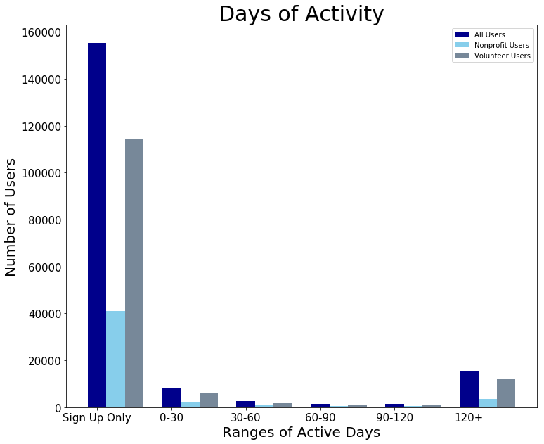
User Drop-off Continued
Q1
Q2
Q3
Q4
Results
Dropoff Before Completion
Non-Profit Users: 69.64%
Volunteer Users: 53.93%
2. Analyst Defined Dropoff
Non-Profit Users: 88.93%
Volunteer Users: 88.49%
3. Users falling in specific ranges
Chart provided

